Slide 1
TRASH-IT
Senior Design II
Team 12

Slide 2
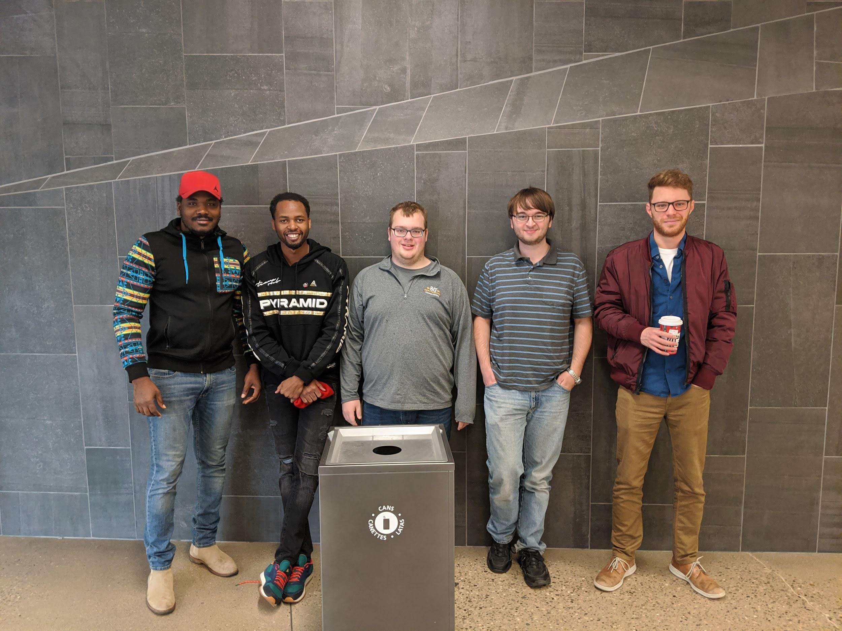
Team 12
Zion Armstrong
Daniel Artz
Trent Church
Magloire Redah
Dieudonne Muhirwa

Slide 3
Table of Contents
Project Goals
Design Approach
Embedded system
Companion app
Demonstration
Test & Analysis
Summary of Results
Conclusion

Slide 4
Project Goals
Dieudonne Muhirwa

Slide 5
What we designed
Casing for electronic to attach to the trash bin
Companion App (Android)
Firebase database
Trash bin embedded system

Slide 6
What we built
Casing for electronic to attach to the trash bin
Companion App (Android)
Firebase database
Trash bin embedded system
Was not able to add weight sensors
Did not have strong enough servo to lift lid
Did not attach system to trash bin

Slide 7
Design Approach: Fabrication
Zion Armstrong

Slide 8
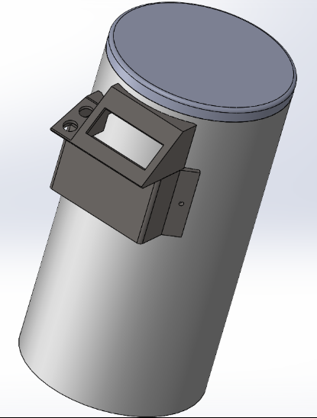
Solidwork assembly
Holds the electrical components of the smart trash bin
Easily accessible on the side of trash bin

Slide 9
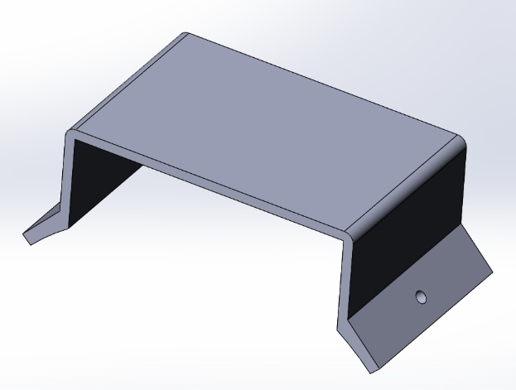
Electronic holder
Designed to fasten to the rounded side of trash bin via two screw holes
Covers Raspberry Pi and Arduino
Provides support for LCD/motion sensor holder

Slide 10
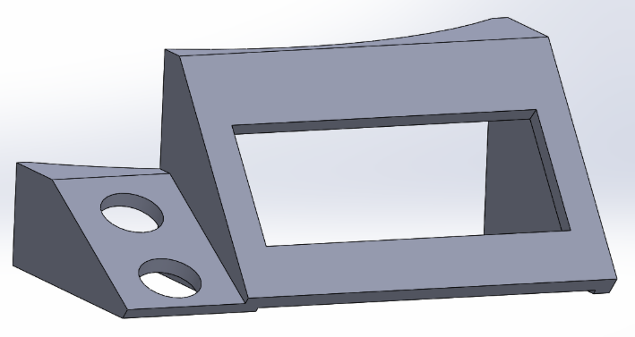
LCD and motion sensor holder
Right side of case to house LCD screen
Left side of case contains motion sensing device
Attaches to top of Arduino/Pi casing
Back designed to fit around the trash bin

Slide 11
Design Approach: Overview
Daniel Artz

Slide 12
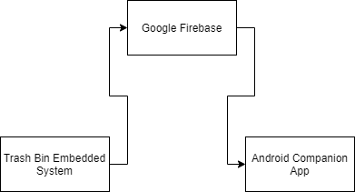
Design Approach Overview

Slide 13
Design Approach: Embedded System
Trent Church

Slide 14
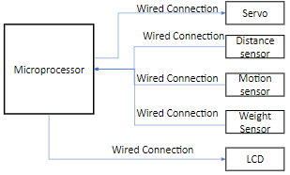
System Overview
1.Microprocessor – A device with memory processor IO.
2.Servo - A Servo is a small device that incorporates DC motor, and an integrated circuit to rotate an output shaft.
3. Distance sensor – A device capable of measuring the distance between itself and another object (measures the height of the trash bin).
4.Motion sensor – A device capable of measuring an object’s movement within range.
5.Weight sensor – Devices that measure the effect of earth’s gravity on an object.
6. LCD – A device to display data

Slide 15
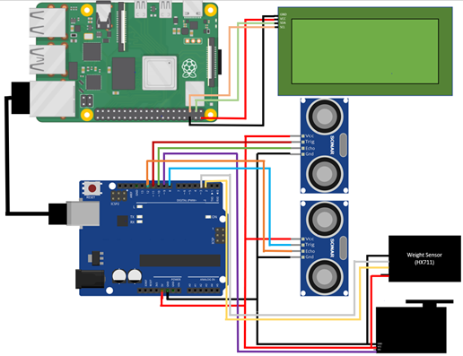
System Pinout
1.Raspberry Pi - Raspberry Pi 3B+
2. Arduino Uno
3. LCD - 20x4 character LCD
4. Distance sensor – Ultrasonic Sensor
5.Motion sensor – Ultrasonic Sensor
6.Weight sensor – Load cell sensors
7. Servo - D-20MG

Slide 16
Design Approach: Embedded System Software
Trent Church

Slide 17
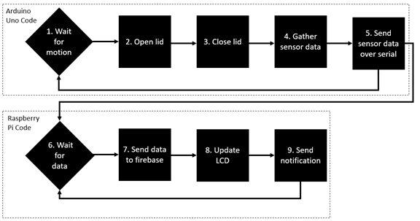
Arduino Uno Code
Wait for motion: Blocker that waits for the motion sensor to detect motion
Open Lid: Statement to use the servo to open the lid for at least 4 seconds
Close Lid: Statement to use the servo to close the lid
Gather sensor data: statement to gather the data from both the height and weight sensors and convert them to percents
Send sensor data over serial: Formats the sensor data into a string and sends it via the serial port to the raspberry pi.

Slide 18
Raspberry Pi Code
6. Wait for data: Blocker that wait for data from the Arduino Uno
7. Send data to firebase: Updates data fields, organizes the data into a json and sends it to the firebase database
8. Update LCD: Update the LCD with the most recent data
9. Send notification: send notification if the trash is above the user specified levels

Slide 19
Design Approach: Companion App
Daniel Artz

Slide 20
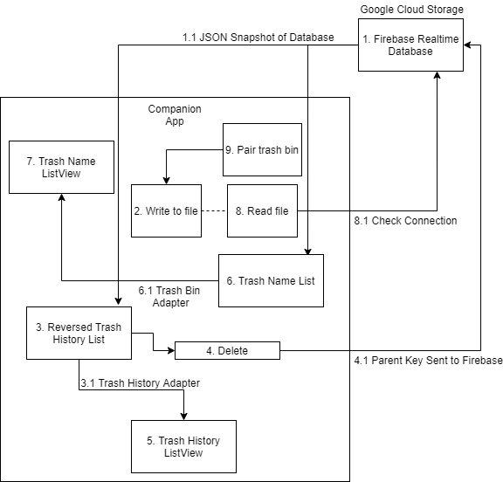
Android Companion App Design Approach
Software functional block definitions
1.) Firebase Realtime Database
1.1)JSON Snapshot of Database
2.)Write to file
3.)Reversed trash list
3.1)Trash History Adapter
4.)Delete
4.1)Parent key Sent to Firebase
5.)Trash History Listview
6.)Trash Name List
6.1)Trash bin adapter
7.)Trash Name Listview
8.)Read file
8.1)Check Connection
9.)Pair Trash Bin

Slide 21
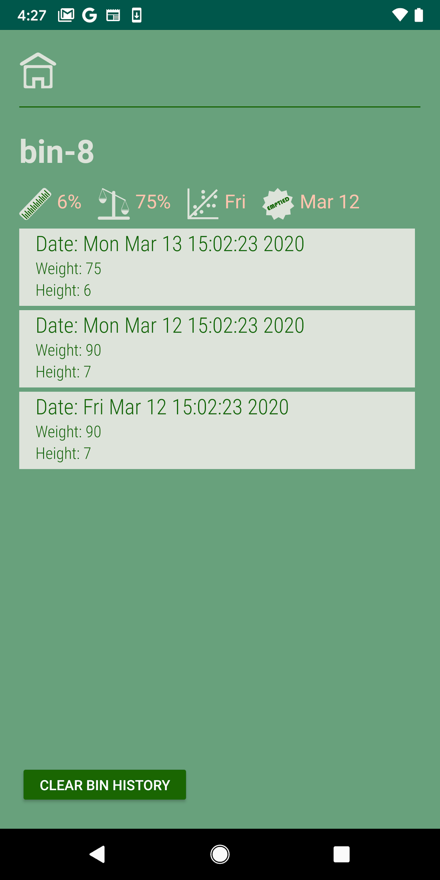
Android App Bin History Screen
Companion App GUI ( Android)
Displays history of trash data
Allows user to clear history
Estimates next day trash bin will be full
Displays the height capacity
Displays the weight capacity
Screen updates live

Slide 22
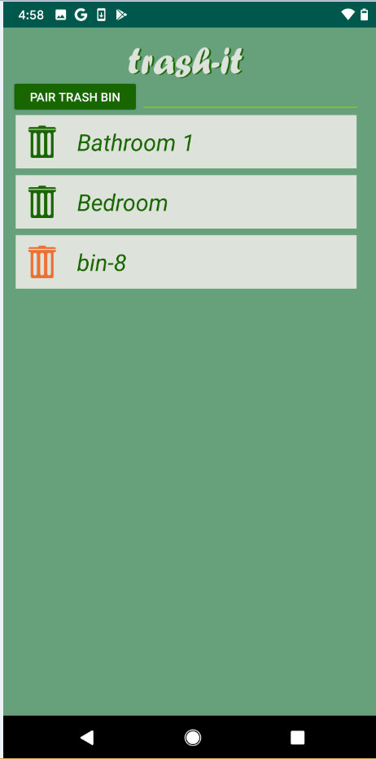
Android App Main Screen
Displays paired trash bins
Allows user to pair new trash bins
Trash bin icon turns orange if height or weight capacity is >= 80%
Screen updates live

Slide 23
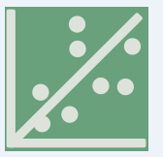
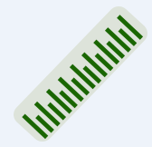
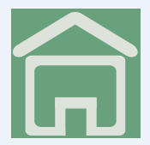
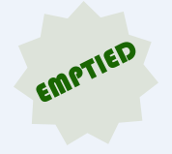
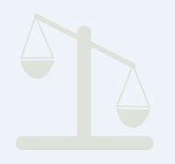
Trash day prediction
trash_day_pred = predicted day the trash bin will be emptied again
height_cap_icon = Current height / height capacity
home_icon = click to go to home screen
last_emptied = date of the last time the trash bin was emptied
weight_cap_icon = current weight / weight capacity

Slide 24
Demonstration: Embedded system
Trent Church

Slide 25
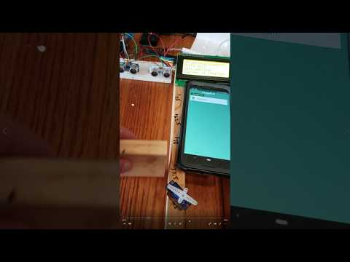

Slide 26
Demonstration: Companion App
Daniel Artz

Slide 27


Slide 28
Testing and Analysis
Magloire Redah

Slide 29
TEST & ANALYSIS
Companion app testing
Tested on multiple phones
Tested with multiple entries
Test by Analysis GIT was used for version control (stored repo on Bitbucket)
Tested with and without an internet connection
Embedded software testing
Tested the upload of multiple data points to the database
Tested multiple waste height
Tested the setup of trash bin

Slide 30
Summary of results
Magloire Redah

Slide 31
Passed tests
(9)
Requirements | Summary
10 | The trash bin held 11.25 liters
20 | The trash bin is equipped with a motion sensing device
21 | Tested at 5cm, 15cm, 25cm, and 35cm
40 | The sensor successfully measured the correct height
41 | The user was notified when the sensor reached the capacity
50 | The App worked on a device using Android 10
51 | User was able to add Maximum weight limit
52 | User was able to add Maximum height limit
53 | The user was notified when the sensor reached the capacity

Slide 32
Failed tests
(4)
Requirements | Summary
22 | While the servo motor was not attached to the lid of the trash bin, it still rotated (COVID-19 impact)
23 | While the servo was not attached, it still activated for 4 seconds(COVID-19 impact)
30 | The lack of weight sensor prevented the measurement of the correct weight(COVID-19 impact)
31 | The lack of weight measurements prevented the user to be notified due the weight capacity being reached (COVID-19 impact)

Slide 33
TEST RESULTS
Companion app: 4 out of 4 passed
Embedded system: 3 out of 3 passed
Requirements: 9 out of 13 passed
Constraints: 11 out of 11 passed
Standards: 6 out of 6 passed
TOTAL TESTS: 33 out of 37 passed

Slide 34
Conclusion
Magloire Redah

Slide 35
Challenges
Parts were never received
Covid 19
Testing remotely
Communicating remotely

Slide 36
Conclusion
In conclusion, due to the lack of parts and testing equipment some of the design objectives and requirements were not met but we were still able to:
Create a companion app that displays pertinent information.
Develop the necessary software to interact with hardware and display appropriate data.
Connect the device to the internet.
Build and connect all available hardware components in an efficient way.

Slide 37
Q & A ?

